Slide 1
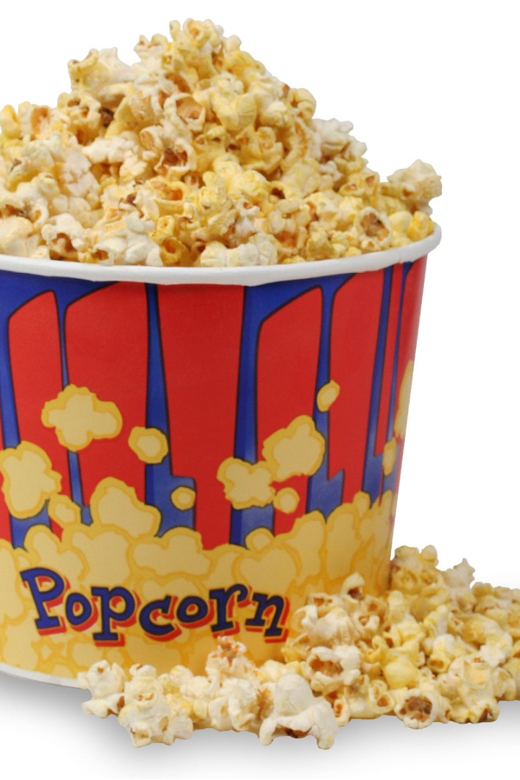
Movie Recommendation System using Machine Learning
Presented by:
Harsh Raj-21bcef54(A1-20)
Rakshyandha Samal-22bcel42(A1-38)
Aniket kumar singh-22bcel48(A1-35)
Vishal kumar singh-22bcel34(A1-37)

Slide 2
Table of contents:
Objective
Purpose
Importance
Data collection and processing
Methods of making the system
Dataset
Proposed model
Model training and Evaluation
Technology Used
Implementation
User Interface
Future plans
Summary

Slide 3
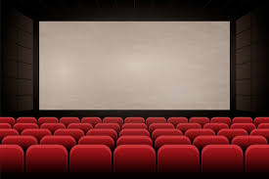


Objective
The goal of a movie recommendation system in a machine learning project is to make users happy by giving them movie suggestions they're likely to love. It does this by looking at what movies users have liked before, how they've behaved on the platform, and some basic info about them. The idea is to give each person recommendations that fit their unique tastes, making their time spent watching movies more enjoyable. The system wants to keep users around, get them to watch more movies, and use smart computer algorithms to keep getting better at suggesting films that users will really like.

Slide 4
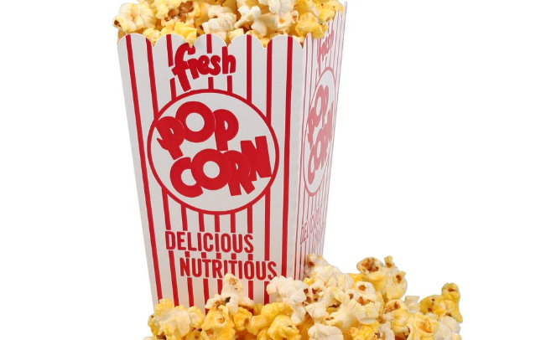
Purpose of the Project
The purpose of this project is to create an accurate and efficient movie recommendation system that suggests the best movies based on a user’s preferences and behaviour.

Slide 5
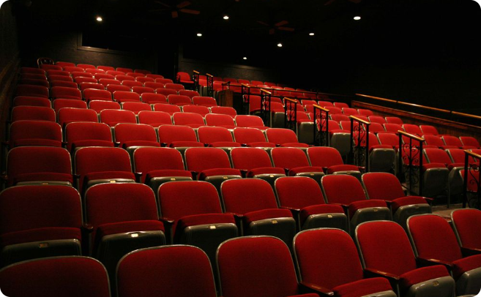
Importance of Movie Recommendation Systems
Nowadays, seeing movies are common. There are many OTT platform introduced for that so, Movie recommendation systems have become an increasingly important aspect of the movie industry and as well as OTT platforms, providing personalized recommendations for the audience, improving user experience and their sales.

Slide 6

Data Collection and processing
1
Sources of Movie Data
We will be using a dataset, one of the most comprehensive sources of movie data available, containing numerous features and vote averages of nearly 4803 movies.
Data Filtering
2
We preprocessed the data to remove duplicates and null values, and then filtered the data by user votes, and, creating a clean dataset of relevant movies and users.
3
Feature Engineering
We engineered several movie features such as genres, directors, keywords, tagline to help facilitate the recommendation process.

Slide 7
Methods of making a Movie Recommendation System
Popularity-based system
Content-based system
Collaborative-based system
Content-based filtering uses movie features such as genres, directors, actors and voting_averages to recommend movies with similar characteristics to those the user has enjoyed in the past.
Popularity-based system uses those data that shows the top movie or top 10 movies, most-viewed movie in India or world.
Collaborative filtering is based on the concept that people who share common interests may like to watch similar types of movies.
We used both popularity based and Content-based approach to create a model that provides more accurate and diverse recommendations.

Slide 8
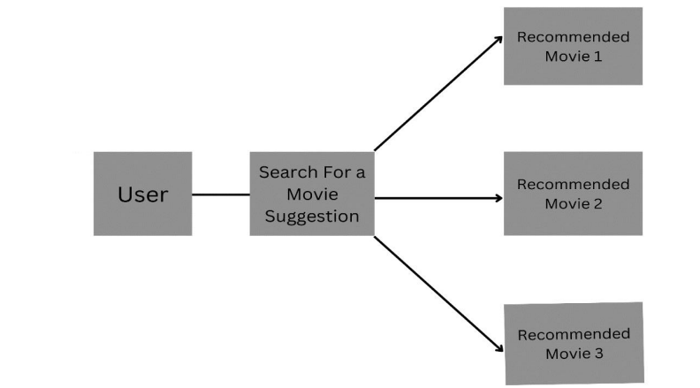
Proposed model
.
.
.
.
.
Recommend movie-10

Slide 9
Data set:
The data set used here contains 4803 different types of movies.
Each movies are of different types of genre.
Each movie has their own popularity scores and vote_counts.

Slide 10
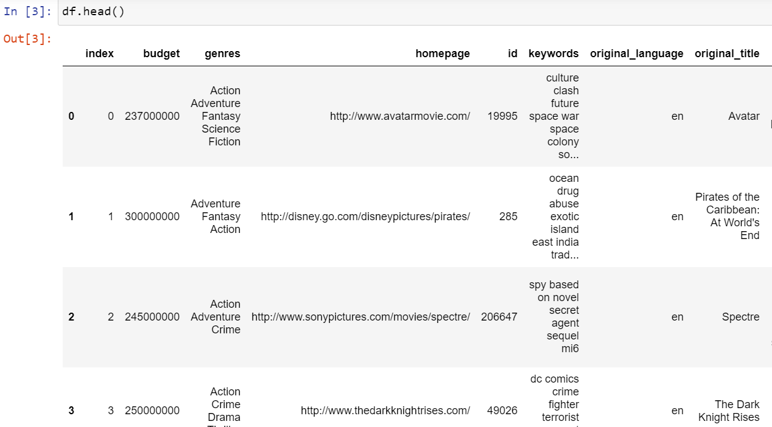
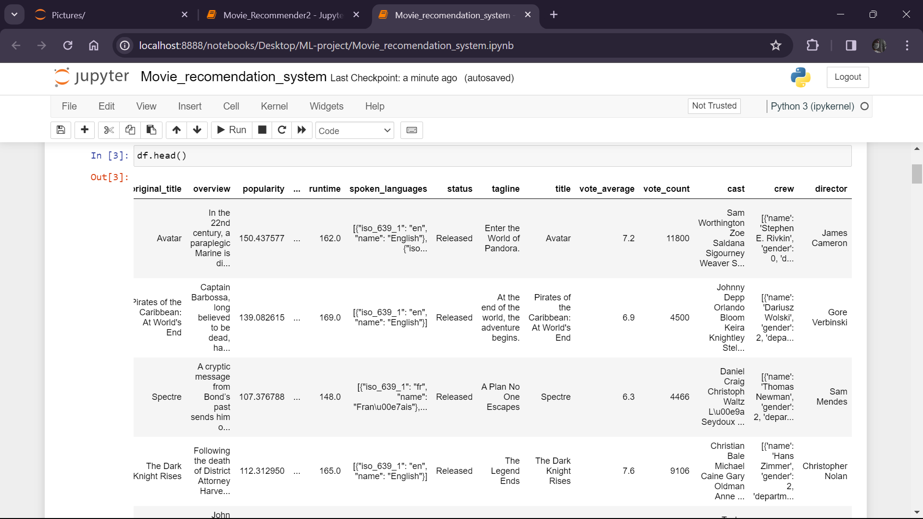
Dataset

Slide 11
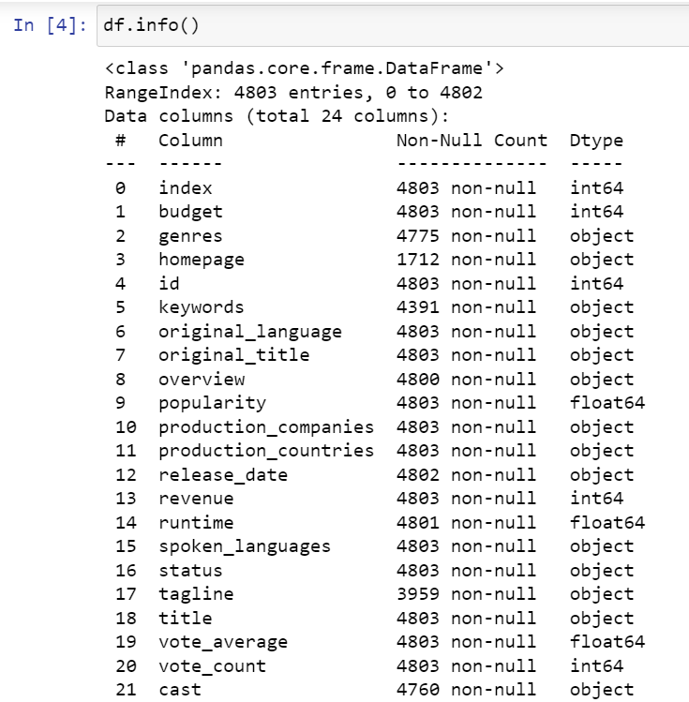
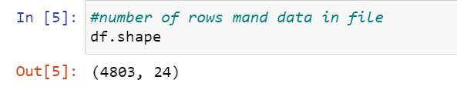
Information about the Dataset
The no. of rows and columns in the datset.

Slide 12
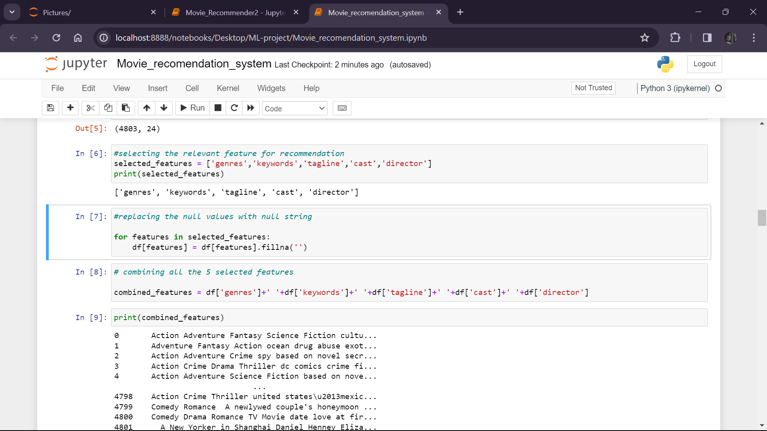
Selecting IMPORTANT features
Printing the selected features:

Slide 13
Model Training and Evaluation
1
Selecting the important features
We selected the important features from the dataset that can be used to recommend movies as person interest.
Training the Recommendation Model
2
We used different methods like tfidfvectorizer, cosine similarity allowing them to learn from the features of previously watched movies and build a model for personalized recommendation.
3
Evaluating the similarity score, close match
We used similarity scores between various movies, close match of movies to build the performance and accuracy of the recommendation system.

Slide 14
Technologies Used
Python and Its Libraries :
Python: A versatile and high-level programming language known for its readability and ease of use.
NumPy: A fundamental package for scientific computing, enabling efficient manipulation of arrays and matrices.
Difflib: This module provides classes and functions for comparing sequences. It can be used for comparing files.
Seaborn: Seaborn is a library for making statistical graphics in Python. It builds on top of matplotlib and integrates closely with pandas data structures. Seaborn helps you explore and understand your data.
Sklern: Scikit-learn (Sklearn) is the most useful and robust library for machine learning in Python. It provides a selection of efficient tools for machine learning and statistical modeling including classification, regression, clustering and dimensionality reduction via a consistence interface in Python

Slide 15
Implementation
Vectorization
Vectorization is a step in feature extraction. The idea is to get some distinct features out of the text for the model to train on, by converting text to numerical vectors.
tfidvectorizer
It measures how important a term is within a document relative to a collection of documents.
Cosine similarity
Cosine similarity is the cosine of the angle between two vectors and it is used as a distance evaluation metric between two points in the plane. The cosine similarity measure operates entirely on the cosine principles.

Slide 16
Close_match
The get_close_matches() function returns a list of close matched strings that satisfy the cutoff. The order of close matched string is based on similarity score, so the most similar string comes first in the list.
Similarity_Scores
Similarity scoring is equivalent to seeking out points in the multidimensional space that are near enough to each other to potentially represent the same true location.

Slide 17
User Interface
Designing the System
We used the various methods used in unsupervised learning for building a system so that it provides a user-friendly interface and displays personalized recommendations to the user.
Creating a User-friendly system
We designed an intuitive and user-friendly system that allows users to enter and search for movies, view movie details, and receive personalized recommendations making it easy and enjoyable to discover new movies.

Slide 18
Future plans:
Web app or mobile app: Create a user-friendly interface which involves searching for movies, providing feedback where users can interact with the recommendation system.
API integration: Develop an API for the recommender system to allow access from other applications which enables partnerships with online movie streaming services.
Dynamic recommendation updates: Consider implementing real-time updates to the recommendations based on new user ratings, movie releases, and trending content.

Slide 19

Summary of the Project
We successfully developed an accurate and efficient movie recommendation system using machine learning that provides personalized recommendations to users based on their behaviour.

Slide 20
References:
Movie Recommender Systems: Concepts, Methods, Challenges, and Future Directions Sambandam Jayalakshmi,¹ Narayanan Ganesh,¹ Robert Čep,^{2,*} and Janakiraman Senthil Murugan³by national library of medicine
2 .Ghuli, P., Ghosh, A., Shettar, R.: A collaborativeﬁltering recommendation engine in a distributed
environment. In: 2014 International Conference on Contemporary Computing and Informatics
(IC3I). IEEE (2014)
3. Zhao, L., et al.: Matrix factorization + for movie recommendation. In: IJCAI (2016)
4. Bhatt, B.: A review paper on machine learning based recommendation system. Int. J. Eng. Dev.
Res. (2014)
5. Wakil, K., et al.: Improving web movie recommender system based on emotions. (IJACSA) Int.
J. Adv. Comput. Sci. Appl. 6(2) (2015)
6. Debnath, S., Ganguly, N., Mitra, P.: Feature weighting in content based recommendation system
using social network analysis. In: Proceedings of the 17th International Conference on World
Wide Web. ACM (2008)

Slide 21
THANK YOU

